Slide 1

SKILLS
WE MAKE YOUR FUTURE BRIGHT

Slide 2
GREETINGS!
SYEDA SABA QUASAR
0211bba104
MAYANK ARORA
0211bba071
SANYA JINDAL
0211bba389
NAMAN GUPTA
0211bba099
DAKSH
0211bba107

Slide 3
CONTENT
EXECUTIVE SUMMARY
01
BUSINESS DESCRIPTION
02
MARKET ANALYSIS AND
STRATEGY
MARKETING AND SALES
PLAN
03
04
COMPETITIVE ANALYSIS
MANAGEMENT AND ORGANIZATION DESCRIPTION
05
06
03
04
PRODUCTS AND SERVICES DESCRIPTION
07
08
OPERATING PLAN
FINANCIAL PROJECTION AND NEEDS
09
EXHIBITS AND APPPENDICES
10
04

Slide 4
EXECUTIVE SUMMARY
What
Why
How
USP
Notes:
What are we
In this world where a pandemic has also taught us the significance and power of technology, we need to devise a mechanism for enhancing the virtual education system, and here with SKILLS, we aim to integrate education and technology by providing easy to use and user-friendly applications with live assistance to aid user whenever stuck.
What problem are we solving
there are so many applications that provide similar features but we provide them in a more accessible way and additional features by taking surveys, feedbacks and user needs in mind.
USP
we understand the need of being dynamic and have an ever-evolving approach.

Slide 5
Business Description
MISSION
Most preferred education technology platforms across the globe.
VISION
One-to-one learning, holistic involvement and lifelong learning
VALUE
Innovation and feedback
Notes:
Our aim is to become one of the most preferred education technology platforms across the globe.
We believe in the power of one-to-one learning that addresses every child's learning needs, allows students to be holistically involved in their education and be active, lifelong learners.
We value and promote Innovation. We also understand the importance of feedback and have incorporated it in our application.

Slide 6
Marketing Analysis and Strategy
Target Audience:
Tap into Student’s Behaviour with Amazon
Grade one to students trying to crack entrance exams .
A unique and customized learning experience to the students.
Revenue Model:
Strategy:
Freemium business model
Concentrate on target audiences

Slide 7
Marketing and Sales Plan
01
Goes Feet-on-Street:
02
Targeting the Parent Community:
03
ADVERTISEMENTS IN REGIONAL LANGUAGES
04
COLLABORATION WITH REGIONAL CELEBS.

Slide 8




Competitives Analysis
Vedantu
Toppr
Unacademy
Byjus
Live Online Tutoring
Better learning for better results.
“India's largest learning platform”
The learning App

Slide 9
UNIQUE ASPECTS OF BYJUS THAT MAKE STAND OUT FROM THE REST-
•They also host live online tutoring classes computer coding for kids and prep courses for several competitive exams
01
02
•The programs that BYJU’S has to offer are more comprehensive and interactive as they use movie-like videos and game-like interaction in their content.
03
04
•BYJU’’s courses are multilingual, .i.e., Hindi, Malayalam, Kannada, Telugu, etc. This gives them a greater reach and makes their offerings more inclusive
Unlike many learning platforms in this list, BYJU’S is a one-stop-solution for all afterschool learning needs

Slide 10
Management and organisation description
MANAGMEMENT
ORGANIZATION
WEBINAR
Management is defined as the procedure of organising, directing, planning and controlling the efforts of organisational members and of managing organisational sources to accomplish particular goals. Planning is the purpose of ascertaining in advance what is supposed to be done and who has to do it.
An organizational structure is a system that outlines how certain activities are directed in order to achieve the goals of an organization. These activities can include rules, roles, and responsibilities.
The organizational structure also determines how information flows between levels within the company.

Slide 11
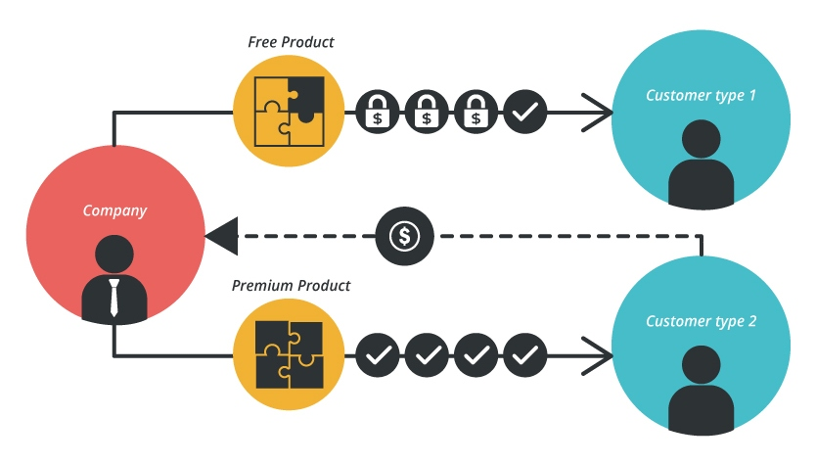
Two Types Of Structure
INFORMAL
FORMAL

Slide 12
Products
We provide application which is available in form of app and can be accessed via any web browser.
Notes:
We provide a GLOBALLY ACCESSIBLE product which can be accessesd in form of an app or from any browser

Slide 13
MULTIPLE DEVICE COMPATIBILE
1
2
3
4
LAPTOP
TABLET
COMPUTER
MOBILE
Notes:
So you can excess are application with any devise wethr it be a

Slide 14
Services
01
Video Lectures
04
Live support and Doubt clearing sessions
02
Regular Assesments
05
Quizes and Mock tests
03
Interactive Learning
06
E-Books and Resources
Notes:
Are application provides following services ----------------------- all these services have ainstant feedback so that we can improve and fix are flaws

Slide 15
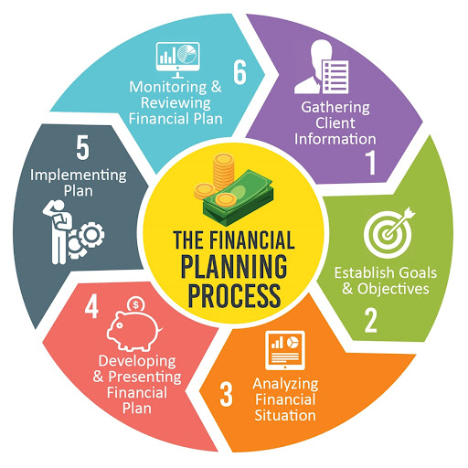
Financial Projection and Need

Slide 16
Operating plan
Quality
Management
Reputation
Networking
Focusing on quality of education rather than quantity
Proper planning, management and execution of services
Establishing a brand name with high reputation
We belive in improving user experience

Slide 17

THANK YOU

